Slide 1
Theory of Automata
Context Free Grammars
Week 8

Slide 2
Contents
Simplification of CFGs
  Killing Λ-Productions
  Killing unit-productions
  Removing Useless Variables
    Symbols & Productions
  Augmented Grammar
  Removal of Left Recursion
  Expression Grammar
  Left Factoring
Theory of Automata

Slide 3
Killing Λ-Productions
Λ-Productions:
In a given CFG, we call a non-terminal N nullable
if there is a production N → Λ, or
there is a derivation that starts at N and lead to a Λ.
N ➔ ……… ➔ Λ
Λ-Productions are undesirable.
We can replace Λ-production with appropriate non-Λ productions.
Theory of Automata

Slide 4
Theorem 23
If L is CFL generated by a CFG having Λ-productions, then there is a different CFG that has no Λ-production and still generates either the whole language L (if L does not include Λ) or else generate the language of all the words in L other than Λ.
Replacement Rule.
Delete all Λ-Productions.
Add the following productions:
  For every production of the X → old string
  Add new production(s) of the form X → .., where right side will account for every modification of the old string that can be formed by deleting all possible subsets of null-able Non-Terminals, except that we do not allow X → Λ, to be formed if all the character in old string are null-able
Theory of Automata

Slide 5
Example
Consider the CFG
S → a | Xb | aYa
X → Y | Λ
Y → b | X
X is nullable
Y is nullable
Old nullable New
Production Production
X → Y nothing
X → Λ nothing
Y → X nothing
S → Xb S → b
S → aYa S → aa
So the new CFG is
S → a | Xb | aa | aYa |b
X → Y
Y → b | X
Theory of Automata

Slide 6
Example
Consider the CFG
S → Xa
X → aX | bX | Λ
X is nullable
Old nullable New
Production Production
S → Xa S → a
X → aX X → a
X → bX X → b
So the new CFG is
S → a | Xa
X → aX | bX | a | b
Theory of Automata

Slide 7
Example
S → XY
X → Zb
Y → bW
Z → AB
W → Z
A → aA | bA | Λ
B → Ba | Bb | Λ
Null-able Non-terminals are?
A, B, Z and W
Theory of Automata

Slide 8
Example Contd.
S → XY
X → Zb
Y → bW
Z → AB
W → Z
A → aA | bA | Λ
B → Ba | Bb | Λ
Old nullable New
Production Production
X → Zb X → b
Y → bW Y → b
Z → AB Z → A and Z → B
W → Z Nothing new
A → aA A → a
A → bA A → b
B → Ba B →a
B → Bb B → b
So the new CFG is
S → XY
X → Zb | b
Y → bW | b
Z → AB | A | B
W → Z
A → aA | bA | a | b
B → Ba | Ba | a | b
Theory of Automata

Slide 9
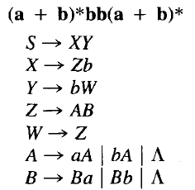
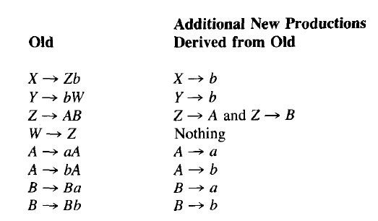
Remove Nulls
Theory of Automata

Slide 10
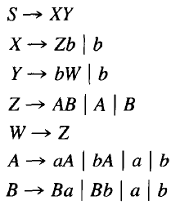
Theory of Automata

Slide 11
Killing unit-productions
Definition: A production of the form
  non-terminal → one non-terminal
is called a unit production.
The following theorem allows us to get rid of unit productions:
Theorem 24:
If there is a CFG for the language L that has no Λ-productions, then there is also a CFG for L with no Λ-productions and no unit productions.
Theory of Automata

Slide 12
Proof of Theorem 24
This is another proof by constructive algorithm.
Algorithm: For every pair of non-terminals A and B, if the CFG has a unit production A → B, or if there is a chain
A ➔ X₁ ➔ X₂ ➔ … ➔ B
where X₁, X₂, ... are non-terminals, create new productions as follows:
If the non-unit productions from B are
B → s₁ | s₂| …
where s₁, s₂, ... are strings, we create the productions
A → s₁| s₂| …
Theory of Automata

Slide 13
Example
Consider the CFG
S → A| bb
A → B | b
B → S | a
The non-unit productions are
S → bb A → b B → a
And unit productions are
S → A
A → B
B → S
Theory of Automata

Slide 14
Example contd.
Let’s list all unit productions and their sequences and create new productions:
S → A gives S → b
S → A → B gives S → a
A → B gives A → a
A → B → S gives A → bb
B → S gives B → bb
B → S → A gives B → b
Eliminating all unit productions, the new CFG is
S → bb | b | a
A → b | a | bb
B → a | bb | b
This CFG generates a finite language since there are no non-terminals in any strings produced from S.
Theory of Automata

Slide 15
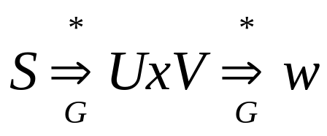
Useless Symbols
A symbol that is not useful is useless
Let a CFG G. A symbol x ε (V U ∑) is useful if there is a derivation
Where U and V ε (V U ∑) and w ε ∑*.
A terminal is useful if it occurs in a string of the language of G.
A variable is useful if it occurs in a derivation that begins from S and generates a terminal string
For a variable to be useful two conditions must be satisfied.
The variable must occur in a sentential form of the grammar
There must be a derivation of a terminal string from the variable.
A variable that occurs in a sentential form is said to be reachable from S.
A two part procedure is presented to eliminate useless symbols.
Theory of Automata

Slide 16
Algorithm to remove useless symbols
PART-I
Identify variables that derive terminal strings
Remove non-terminals that do not derive terminal strings.
e.g. following grammar G = S → aS | A | C
A → a
B → aa
C → CB
Theory of Automata

Slide 17
Example
S → aS | A | C
A → a
B → aa
C → CB
We can identify variables that derive terminal strings.
i.e. A → a B → aa
And S ➔A ➔ a TERM = {S, A, B}
But not C. thus C is useless
Theory of Automata

Slide 18
Example
PART - II
Rename the grammar
GT = S → aS | A
A → a
B → aa
Now draw a graph and delete nodes not reachable from S.
As B is unreachable so delete it and the final grammar will be G_{V}=
S → aS | A
A → a
aa
a
S
A
B
Theory of Automata

Slide 19
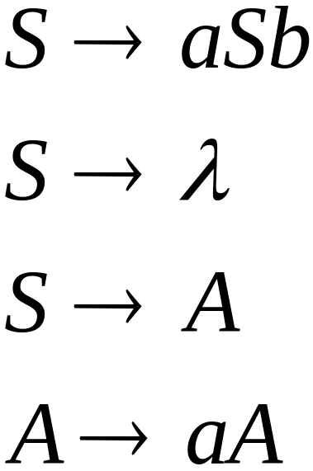
Useless Productions
Useless Production
Some derivations never terminate...
Theory of Automata

Slide 20
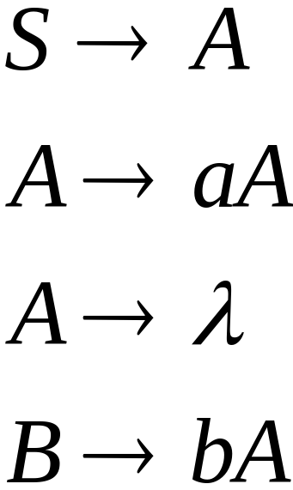
Another grammar:
Useless Production
Not reachable from S
Theory of Automata

Slide 21



In general:
if
and w contains only terminals
then variable is useful
otherwise, variable is useless
Theory of Automata

Slide 22

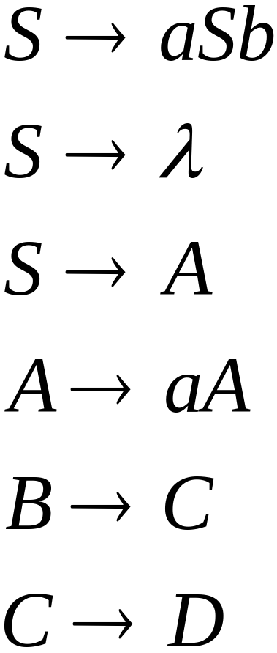
A production is useless
if any of its variables is useless
Productions
Variables
useless
useless
useless
useless
useless
useless
useless
Theory of Automata

Slide 23
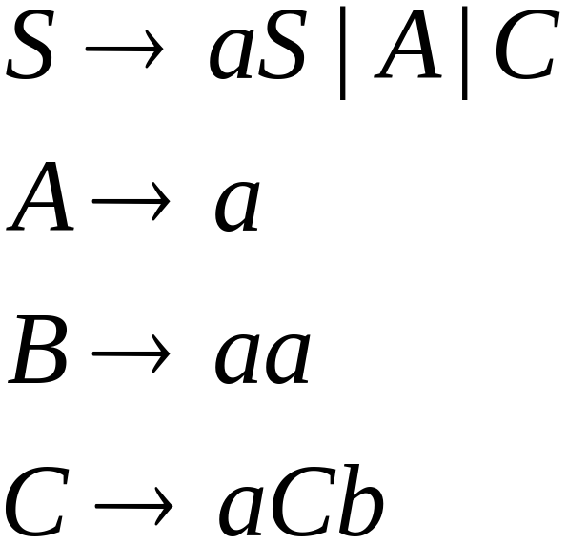
Removing Useless Productions
Example Grammar:
Theory of Automata

Slide 24
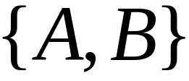

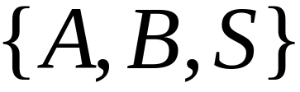
First:
find all variables that can produce
strings with only terminals
Round 1:
Round 2:
Theory of Automata

Slide 25
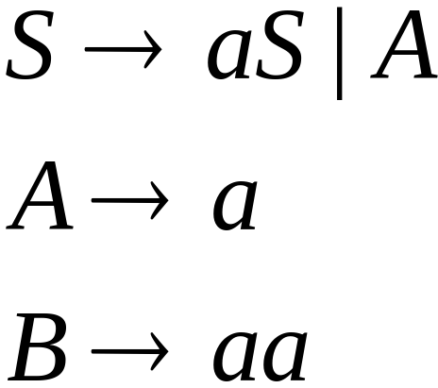
Keep only the variables
that produce terminal symbols:
(the rest variables are useless)
Remove useless productions
Theory of Automata

Slide 26




Second:
Find all variables
reachable from
Use a Dependency Graph
not
reachable
Theory of Automata

Slide 27
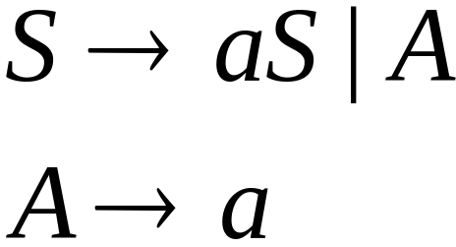
Keep only the variables
reachable from S
(the rest variables are useless)
Final Grammar
Remove useless productions
Theory of Automata

Slide 28
Set of variables that Derive terminal symbols
Input = CFG (V, ∑, P , S)
TERM = { A | there is a rule A→w ε P with w ε ∑*
repeat
  PREV = TERM
  For each variable in A ε V do
    If there is a rule A → w and w ε (PREV U ∑)* then
    TERM = TERM U {A}
Until PREV = TERM
Theory of Automata

Slide 29
Example
Consider following CFG
G: S → AC | BS | B
A → aA | aF
B → CF | b
C →cC | D
D →aD | BD | C
E → aA | BSA
F → bB | b
Theory of Automata

Slide 30
S → AC | BS | B
A → aA | aF
B → CF | b
C →cC | D
D →aD | BD | C
E → aA | BSA
F → bB | b
New Grammar from
TERM will be
G_{T}:
S →BS | B
A → aA | aF
B → b
E → aA | BSA
F → bB | b
Iteration | TERM | PREV
0 | {B, F} | {}
1 | {B, F, A, S} | {B, F}
2 | {B, F, A, S, E} | {B, F, A, S}
3 | {B, F, A, S, E} | {B, F, A, S, E}
Theory of Automata

Slide 31
Construction of set of reachable Variables
Input = CFG (V, ∑, P , S)
REACH = {S}
PREV = null
repeat
  NEW = REACH – PREV
  PREV = REACH
  For each variable A in NEW do
    For each rule A → w do add all variables in w to REACH
Until REACH = PREV
Theory of Automata

Slide 32
G_{T}:
S →BS | B
A → aA | aF
B → b
E → aA | BSA
F → bB | b
G’_{T}:
S →BS | B
B → b
Iteration | REACH | PREV | NEW
0 | {S} | {} | {}
1 | {S, B} | {S} | {S}
2 | {S, B} | {S, B} | {B}
3 | {S, B} | {S, B} | {}
Theory of Automata

Slide 33
Removing All
Step 1: Remove Nullable Variables
Step 2: Remove Unit-Productions
Step 3: Remove Useless Variables
Theory of Automata

Slide 34
Augmented Grammar
Add a new start symbol S₀ S
This change guarantees that the start symbol of the new grammar will not occur on the rhs of any rule.
Theory of Automata

Slide 35
Removal of Left Recursion
Consider the grammar A → Aa | b
Halting condition of top-down parsing depend upon the generation of terminal prefixes to discover dead ends.
Repeated application of above rule fail to generate a prefix that can terminate the parse.
Theory of Automata

Slide 36
Removing left recursion
To remove left recursion from A, the A rules are divided into two groups.
Left recursive and others
A → Au₁ | Au₂ | Au₃ | ….| Au_{j}
A → V₁ | V₂ | V₃ | … | V_{k}
Solution:
A → V₁ | V₂ | V₃ | … | V_{k}| V₁Z | V₂Z | … | V_{k}Z
Z → u₁Z | u₂Z | u₃Z | … | u_{j}Z | u₁ | u₂ | u₃ | … | u_{j}
Theory of Automata

Slide 37
Removal of Left Recursion
Or Equivalently
A → Au₁ | Au₂ | Au₃ | ….| Au_{j}
A → V₁ | V₂ | V₃ | … | V_{k}
Solution:
A → V₁Z | V₂Z | … | V_{k}Z
Z → u₁Z | u₂Z | u₃Z | … | u_{j}Z | λ
Theory of Automata

Slide 38
Example
A → Aa | b
Solution:
A → bZ | b
Z → aZ | a
OR
A → bZ
Z → aZ | λ
A → Aa | Ab | b | c
A → bZ | cZ | b | c
Z → aZ | bZ | a | b
Consider another example
A → AB | BA | a
B → b | c
A → BAZ | aZ | BA | a
Z → BZ | B
B → b | c
Theory of Automata

Slide 39

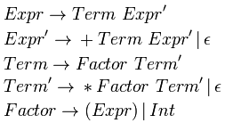
The above transformations remove left-recursion by creating a right-recursive grammar; but this changes the associativity of our rules. Left recursion makes left associativity; right recursion makes right associativity. Example : We start out with a grammar :
After having applied standard transformations to remove left-recursion, we have the following grammar :
Parsing the string 'a + a + a' with the first grammar in an LALR parser (which can recognize left-recursive grammars) would have resulted in the parse tree:
Theory of Automata

Slide 40
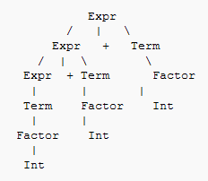
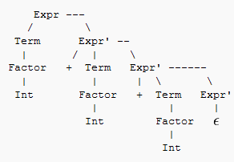
This parse tree grows to the left, indicating that the '+' operator is left associative, representing (a + a) + a.
But now that we've changed the grammar, our parse tree looks like this :
Theory of Automata

Slide 41
We can see that the tree grows to the right, representing a + ( a + a). We have changed the associativity of our operator '+', it is now right-associative. While this isn't a problem for the associativity of addition, it would have a significantly different value if this were subtraction.
The problem is that normal arithmetic requires left associativity. Several solutions are: (a) rewrite the grammar to be left recursive, or (b) rewrite the grammar with more nonterminals to force the correct precedence/associativity, or (c) if using YACC or Bison, there are operator declarations, %left, %right and %nonassoc, which tell the parser generator which associativity to force.
Theory of Automata

Slide 42
Expression Grammar
Ambiguous non-Ambiguous No Left Rec
S → E
E → E + E
E → E – E
E → E * E
E → E / E
E → ( E )
E → num | id
S → E
E → E + T
E → E - T
E → T
T → T * F
T → T / F
T → F
F → ( E )
F → num | id
S → E
E → T E’
E’ → +T E’ | -T E’ | λ
T → FT’
T → * FT’ | / F T’| λ
F → ( E )
F → num | id
Theory of Automata

Slide 43
Left Factoring
The grammar is unambiguous and non-left-recursion but we don't know which rule to apply on a symbol in:
S → VU₁
→ VU₂
→ VU₃
………………
→ VU_{n}
However, it can be factored as follows.
S → VB
B →U₁
→U₂
→U₃
………………
→ U_{n}
Theory of Automata

Slide 44
Should we apply right factoring too?
Theory of Automata

